Slide 1
Introduction to ANIMAL SCIENCE
Objectives:
List 5 functions of domestic animals
Describe and define what considers an animal to be domesticated
Define common terminology used in animal science
Categorize & distinguish animals by breeds, species, and types
List major types & uses of each species of livestock
List & describe benefits of animal agriculture

Slide 2
What animals are used for production purposes?
Beef
Dairy
Sheep
Swine
Dairy goats
Horses
Rabbits
Fish
Fur-Bearing animals
Poultry

Slide 3
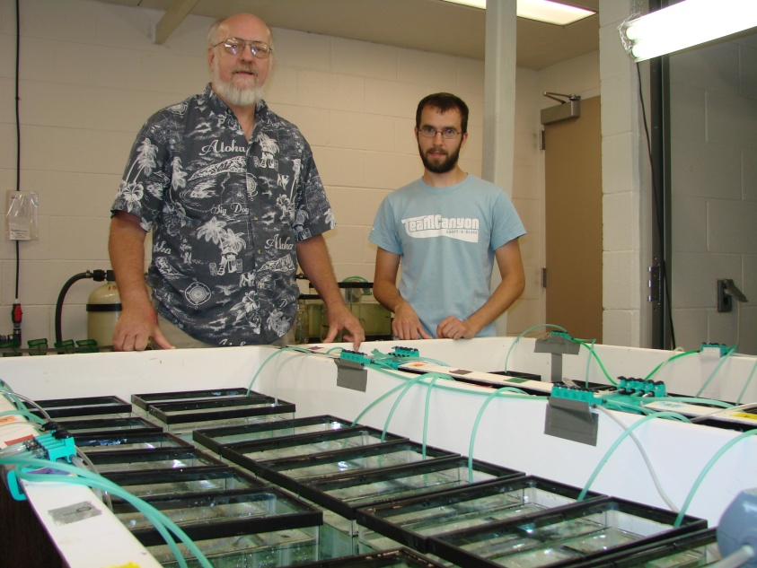
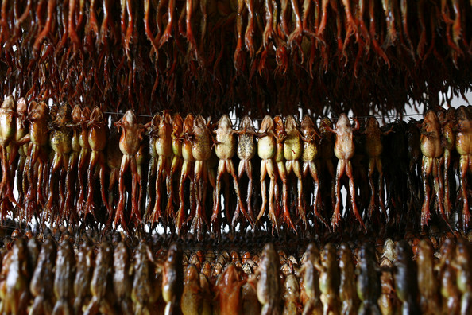
Frog Farming

Slide 4
SCIENCE
a process through which nature is STUDIED, DISCOVERED, and UNDERSTOOD.

Slide 5
Animal Science
The PROCESS through which LIVESTOCK ANIMALS are STUDIED and UNDERSTOOD.

Slide 6
THE ANIMAL INDUSTRY
Animal Industry – activities in producing animals and their products or benefits.
Areas:
Animal Production – producing animals for food.
Animal Supplies – providing inputs needed to produce animals.
Animal Services – the technical and professional assistance needed with animals.

Slide 7
THE ANIMAL INDUSTRY (CONTINUED)
More Areas
Animal marketing – activities that link the producer with the consumer.
Animal products – preparing animals or their products for consumption.

Slide 8
Animal Science
Involves BREEDING, feeding, care and MANAGEMENT of animals; MARKETING and PROCESSING of animals and their PRODUCTS based on knowledge gained through practical EXPERIENCE and RESEARCH.

Slide 9
Domestication
To adapt an animal for human use

Slide 10
Why do we CHOOSE to have animals?
A. List 4 functions of domestic animals

Slide 11
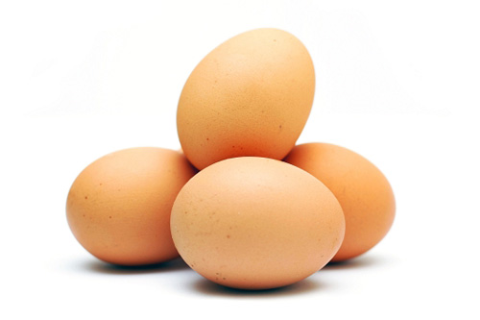
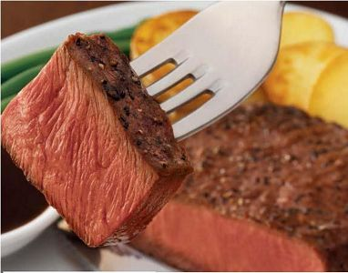
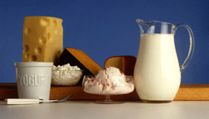
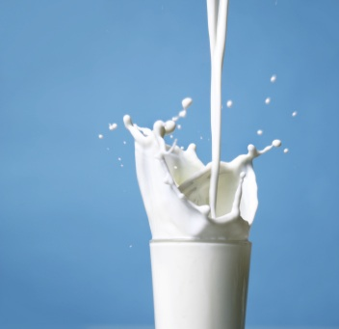
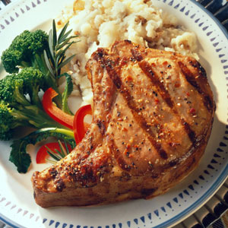
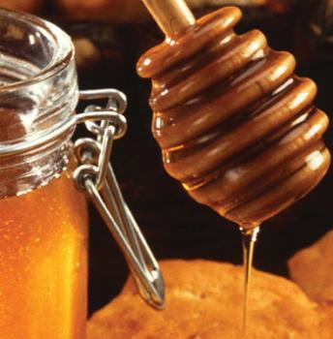
Functions of domestic animals: 1-Food
A. List 4 functions of domestic animals
Meat
Eggs
Milk
Honey

Slide 12
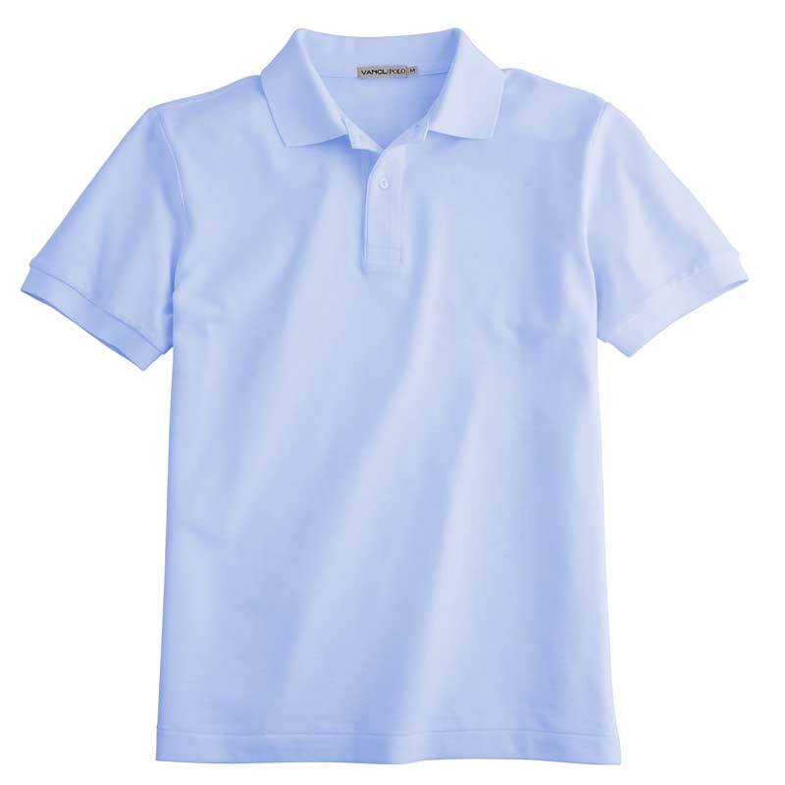
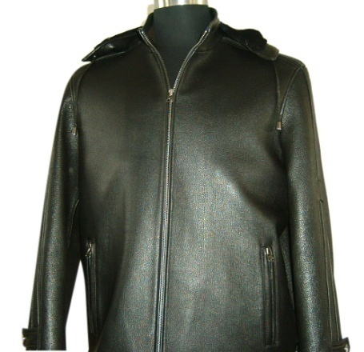
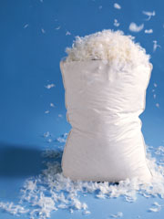
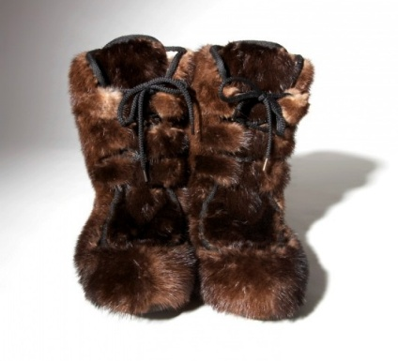
A. List 4 functions of domestic animals
Functions of domestic animals: 2- Clothing
Wool
Leather
Hair/Fur
Feathers

Slide 13
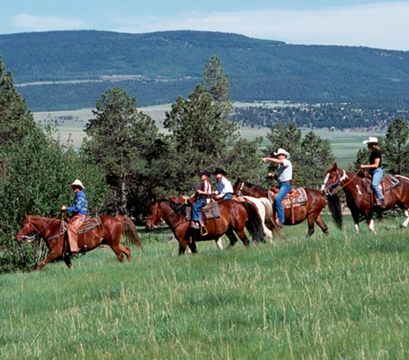
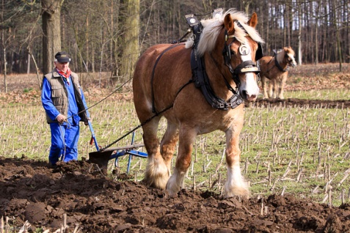
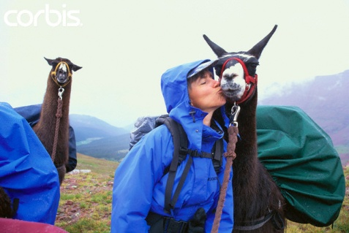
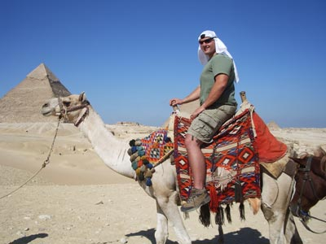
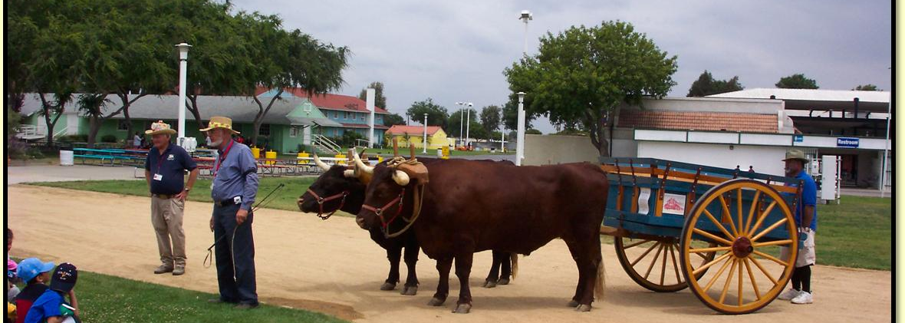
A. List 4 functions of domestic animals
Functions of domestic animals: 3-Power
Horses, Mules, Donkeys, Burros
Llamas, Alpacas
Oxen, Water buffalo, reindeer, yak, camels

Slide 14
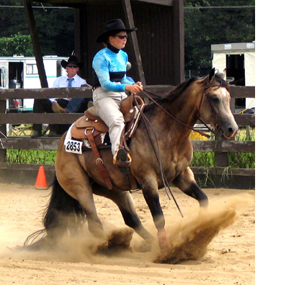
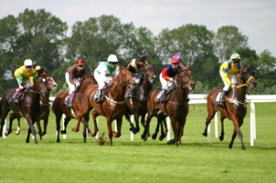
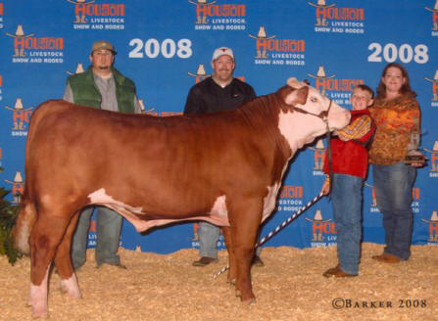
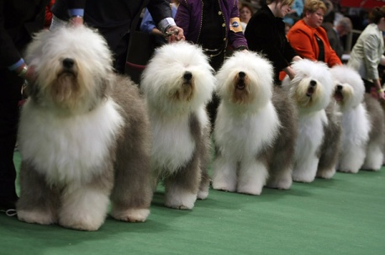
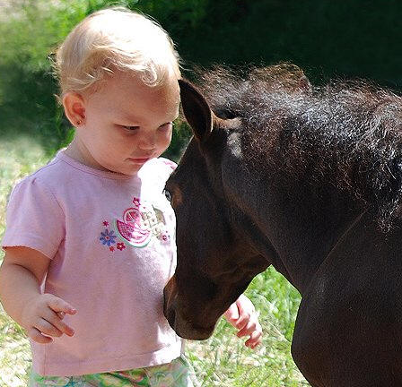
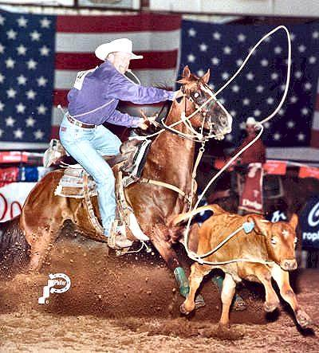
A. List 4 functions of domestic animals
Functions of domestic animals: 4- Recreation & Companionship
Pleasure Horses
Purebred Herds and Flocks
Livestock Exhibitions, Shows, Rodeos
Horse Racing

Slide 15
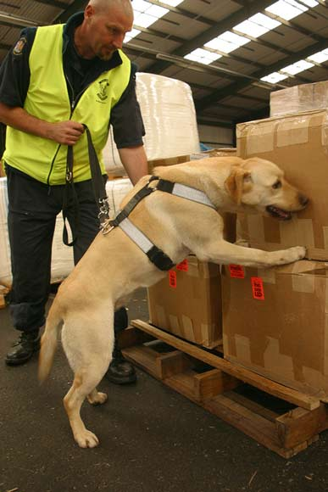
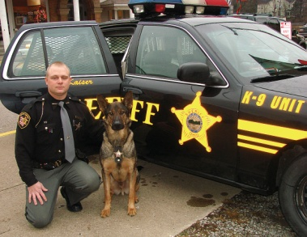
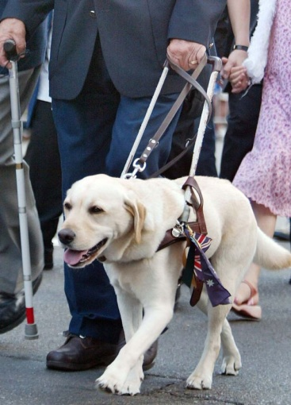
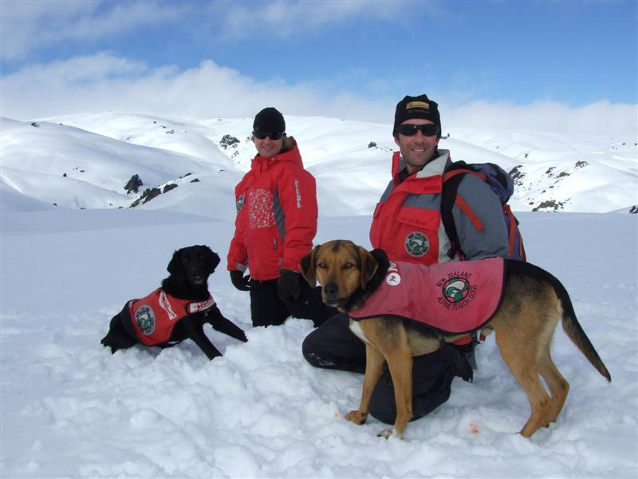
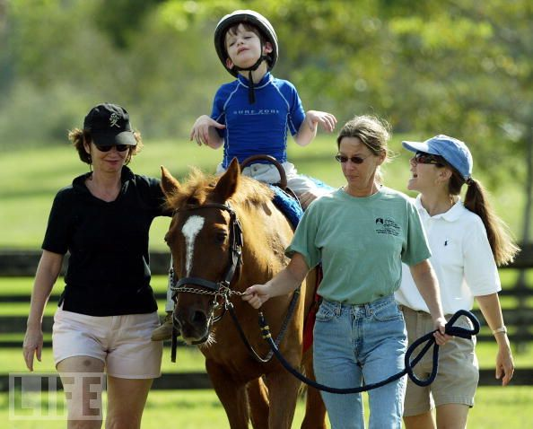
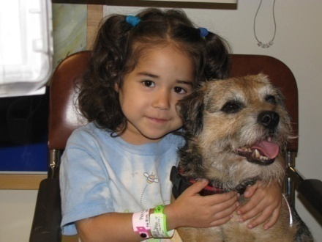
A. List 4 functions of domestic animals
Functions of domestic animals: 5- Service
Guide dogs for blind
Police Dogs
Rescue Dogs
Therapy animals

Slide 16
What is a domesticated animal?
B. Describe and define what considers an animal to be domesticated

Slide 17
B. Describe and define what considers an animal to be domesticated
Requirements for animals to be “domesticated”
1. The animal is VALUED and has a PURPOSE
2. The animal’s BREEDING is subject to human control.
3. The animal’s SURVIVAL depends upon humans.
4. The animal’s BEHAVIOR (psychology) is changed in domestication.
5. STRUCTURAL characteristics have appeared which occur rarely if at all in the wild.

Slide 18
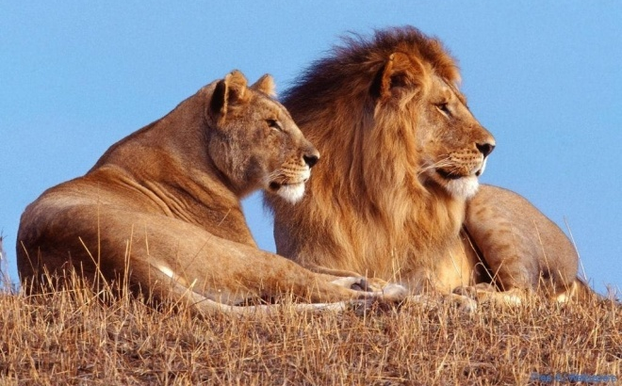
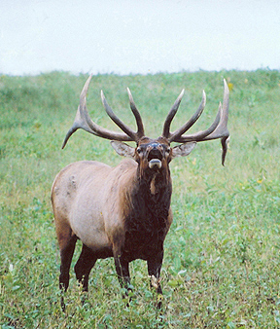
B. Describe and define what considers an animal to be domesticated
Terms:
Wild Animal
Exists without human intervention of any type (feeding, breeding selection, shelter, etc.)
Genetically: Wild
Behaviorally: Wild

Slide 19
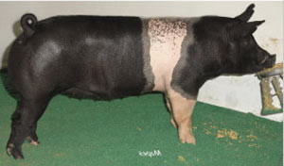
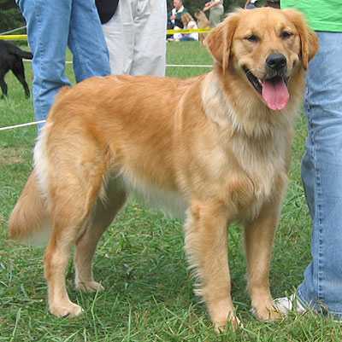
B. Describe and define what considers an animal to be domesticated
Terms:
Domestic Animals
Rely on humans for food & shelter, bred through artificial selection to choose and perpetuate desired traits
Genetically Domestic
Behaviorally= domestic

Slide 20
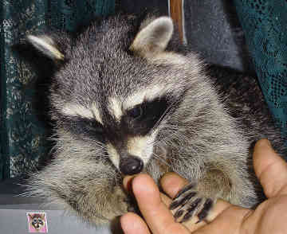
B. Describe and define what considers an animal to be domesticated
Terms:
Tame Wild Animal
A wild animal that has adapted behaviorally to be useful to humans.
Example: bottle feeding a baby raccoon
Genetically=Wild
Behaviorally=Domestic

Slide 21
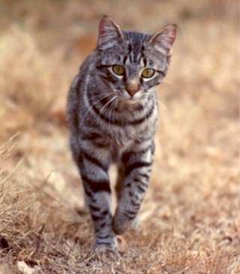
B. Describe and define what considers an animal to be domesticated
Terms:
Feral Animal
A previously domestic animal that returned to the wild
Example: Feral Cat
Genetically=Domestic
Behaviorally= Wild

Slide 22
B. Describe and define what considers an animal to be domesticated
History of Animal Domestication Group Assignment
In groups, research the domestication of the animal you are assigned. Prepare a 2-3 minute explanation answering the questions on your worksheet for the class on your assigned species.
Answer the questions found on your worksheet
Cattle
Swine
Sheep
Goats
Horses
Poultry
Dogs
Cats
Rabbits

Slide 23
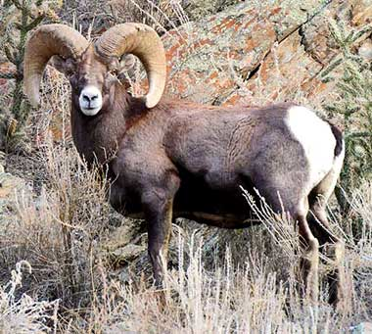
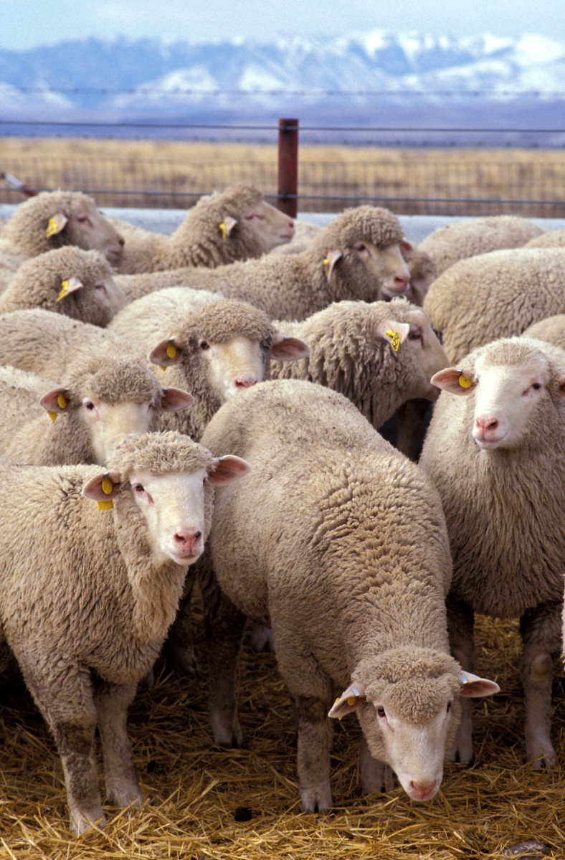
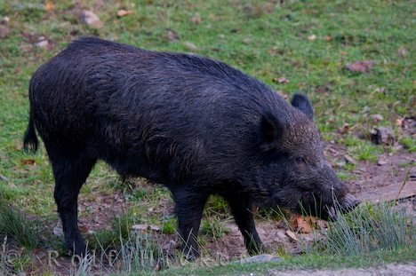
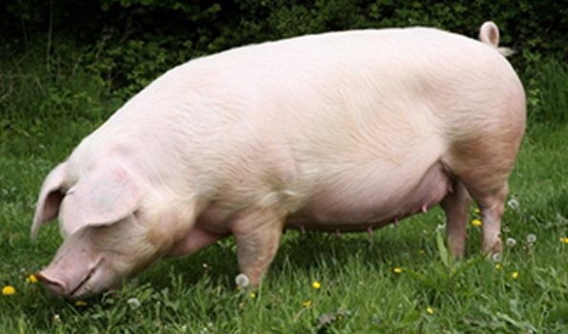
B. Describe and define what considers an animal to be domesticated
Domesticate an Animal
Choose an animal that is currently wild and domesticate it to benefit humans…
**Remember that physical appearance AND behavior changes in the process of domestication!

Slide 24
What is binomial nomenclature?
C. Define common terminology used in animal science
A system used in science to give plants and animals a name

Slide 25
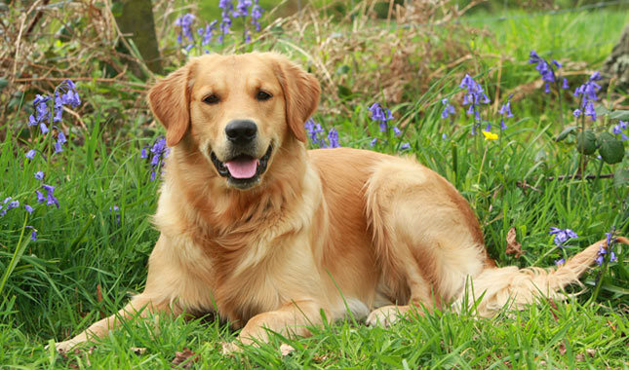
Binomial Nomenclature
C. Define common terminology used in animal science
Canis familiaris
Genus
Family Name
Capitalized & italicized
Species
Individual species name
Lower case & italicized

Slide 26
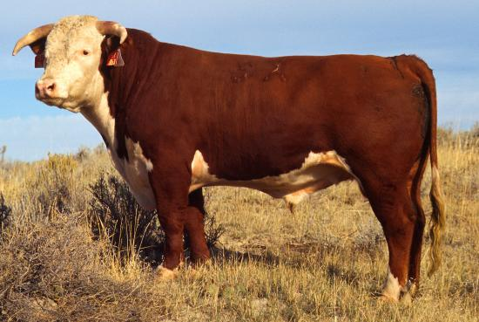
C. Define common terminology used in animal science
European Cattle (Bovine)
*Genus/Species: Bos Taurus
*Baby: Calf
*Young Male: Bullock
*Young Female: Heifer (until 1st calf is born)
*Castrated Male: Steer
*Mature Male: Bull
*Mature Female: Cow
*Group: Herd

Slide 27
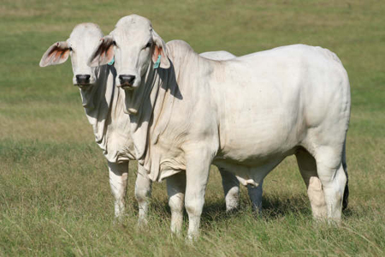
C. Define common terminology used in animal science
Indian Cattle (Bovine)
*Genus/Species: Bos Indicus
*Baby: Calf
*Young Male: Bullock
*Young Female: Heifer (until 1st calf is born)
*Castrated Male: Steer
*Mature Male: Bull
*Mature Female: Cow
*Group: Herd

Slide 28
C. Define common terminology used in animal science
Sheep (Ovine)
*Genus/Species: Ovis aries
*Baby: Lamb
*Young Male: Ram Lamb
*Young Female: Ewe Lamb
*Castrated Male: Whether
*Mature Male: Ram
*Mature Female: Ewe
*Group: Flock

Slide 29
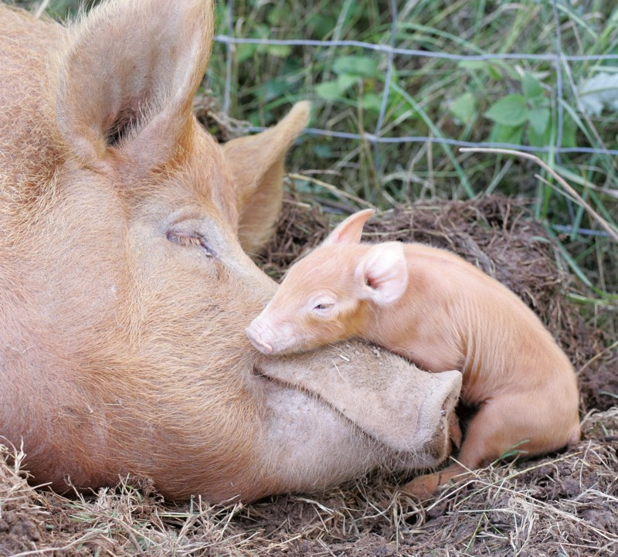
Define common terminology used in animal science
Pigs (Supine)
*Genus/Species: Sus scrofa domestica
*Baby: Piglet
*Young Male: Shoat
*Young Female: Gilt (until 1st litter)
*Castrated Male: Barrow
*Mature Male: Boar
*Mature Female: Sow
*Group: Herd, Drove, or Mob

Slide 30
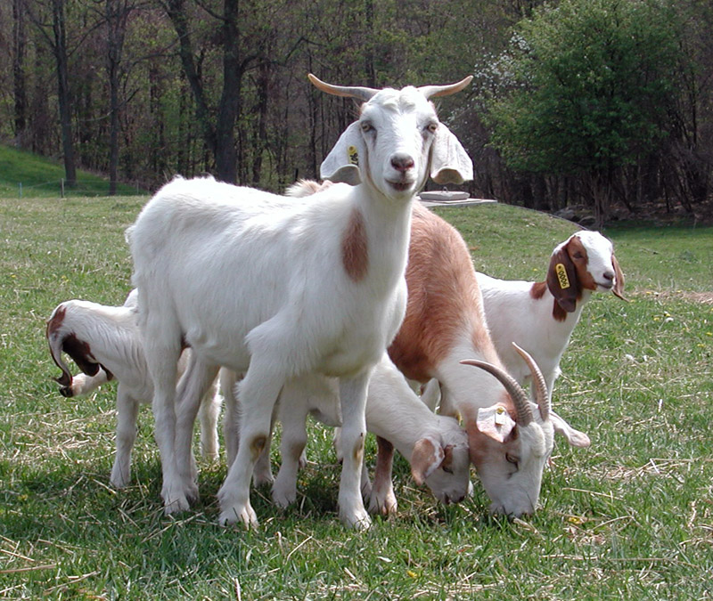
Define common terminology used in animal science
Goats (Caprine)
*Genus/Species: Capra hircus
*Baby: Kid
*Young Male: Ram Kid
*Young Female: Doe Kid
*Castrated Male: Whether
*Mature Male: Billy
*Mature Female: Doe
*Group: herd or tribe

Slide 31
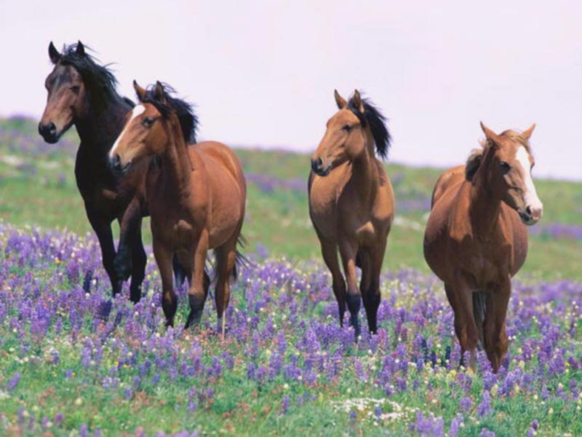
C. Define common terminology used in animal science
Horses (Equine)
*Genus/Species: Equus caballus
*Baby: Foal
*Young Male: Colt
*Young Female: Filly
*Castrated Male: Gelding
*Mature Male: Stallion
*Mature Female: Mare
*Group: Herd

Slide 32
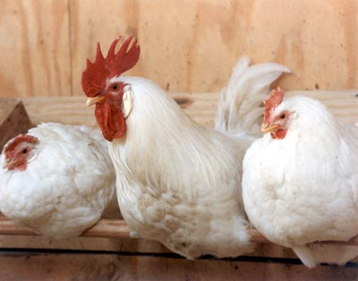
C. Define common terminology used in animal science
Chicken
*Genus/Species: Gallus domesticus
*Baby: Chick
*Young Male: Cockerel
*Young Female: Pullet
*Castrated Male: Capon
*Mature Male: Rooster
*Mature Female: Hen
*Group: Chickens: Brood, Flock, Peep
**FYI:
Turkeys: Rafter, Gobble, Gang
Geese: Gaggle (if they are in flight=Skein)

Slide 33
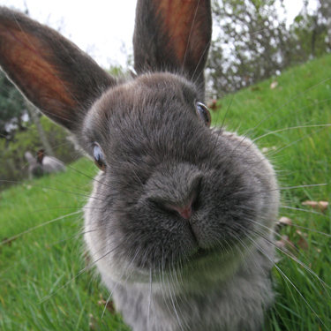
Define common terminology used in animal science
Rabbits
*Genus/Species: Oryctolagus cuniculus
*Baby: Bunny
*Young Male: (None)
*Young Female: (None)
*Mature Male: Buck
*Mature Female: Doe
*Group: Colony, Nest, Herd

Slide 34
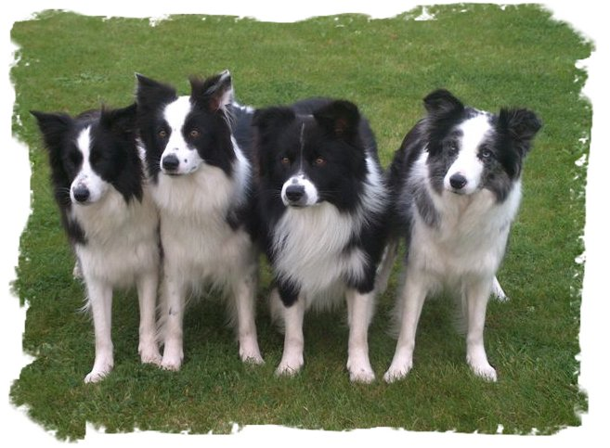
C. Define common terminology used in animal science
Dog (Canine)
*Genus/Species: Canis familiaris
*Baby: Puppy
*Young Male: (None)
*Young Female: (None)
*Mature Male: Stud
*Mature Female: Dam or Bitch
*Group: Pack

Slide 35
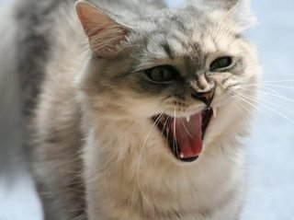
C. Define common terminology used in animal science
Cat (Feline)
*Genus/Species: Felis catus
*Baby: Kitten
*Young Male: (None)
*Young Female: (None)
*Mature Male: Tom
*Mature Female: Queen
*Group: Clowder or Clutter
Video Clip

Slide 36
What is the difference?
D. Categorize & distinguish animals by breeds, species, and types
Species
Breed
Type

Slide 37
D. Categorize & distinguish animals by breeds, species, and types
Species
A group of closely related animals that can interbreed and produce fertile offspring.

Slide 38
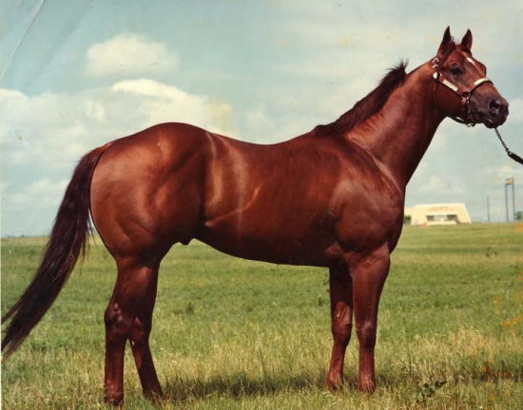
D. Categorize & distinguish animals by breeds, species, and types
Species
Example:
Equine

Slide 39
Categorize & distinguish animals by breeds, species, and types
Breed
Animals of common origin with characteristics that distinguish them from other groups within the same species

Slide 40
Categorize & distinguish animals by breeds, species, and types
Breed
Example:
Equine Breeds
Quarter Horse:
Runs ¼ mile exceptionally fast, medium build, common for ranch work, solid color
Clydesdale:
Draft horse, white feet with feathering, bay in color, usually 16-18 hands tall
Paint:
Similar to quarter horse, but distinguished by color pattern
Arabian:
Distinguished by arched neck, dished forehead, and raised tail

Slide 41
Categorize & distinguish animals by breeds, species, and types
Type
Animals of the same species that are grouped together based on the products they produce

Slide 42
Categorize & distinguish animals by breeds, species, and types
Type
Example:
Cattle
Some produce MEAT exceptionally well
Some produce MILK exceptionally well

Slide 43
Types of Livestock
D. Categorize & distinguish animals by breeds, species, and types
Each species of livestock has specific breeds that perform best for each purpose:
Meat Type: Produce meat efficiently
Dairy Type: Produce milk efficiently
Dual Purpose: Produce meat & milk efficiently
Ornamental: Don’t produce milk or meat efficiently, chosen for beauty
Performance: Chosen for performance traits

Slide 44
E. List major types & uses of each species of livestock
Cattle
Beef Type
Dairy Type
Dual Purpose

Slide 45
E. List major types & uses of each species of livestock
Sheep
Wool type
Meat type
Dual Purpose
FYI: Though they aren’t common, there are dairy type sheep. Some specialty cheeses are made from sheep milk

Slide 46
E. List major types & uses of each species of livestock
Pigs
Meat Type

Slide 47
E. List major types & uses of each species of livestock
Goats
Meat Type
Dairy Type

Slide 48
E. List major types & uses of each species of livestock
Chickens
Eggs (Layers)
Meat (Broilers)
Ornamental
Notes:
**Ornamental chickens still produce eggs and meat, but not as efficiently as layers or broilers. These breeds are typically chosen for their unique look.

Slide 49
E. List major types & uses of each species of livestock
Horses
Performance Type
Draft Type
Racing
Ranch Work/Stock Horse

Slide 50
How does animal based agriculture benefit humans?
F. List & describe benefits of animal agriculture

Slide 51
What are the benefits of Animal Agriculture??
F. List & describe benefits of animal agriculture
Animals convert feed that humans CAN’T eat to food humans CAN eat
(poor hay, corn stalks, straw, etc.)
Helps maintain fertility of the land

Slide 52
What are the benefits of Animal Agriculture??
F. List & describe benefits of animal agriculture
Personal satisfaction of working with domesticated animals
May more fully utilize capital, machinery and wasteland (range).

Slide 53
What are the benefits of Animal Agriculture??
F. List & describe benefits of animal agriculture
Food Value:
Animal proteins are superior to vegetable proteins for humans
Animal proteins have improved amino acid balance over vegetable protein
Milk -- approximately 90% of milk for human consumption in the world comes from cattle
Over 85% of the world population desires food of animal origin

Slide 54
Animal By-Products
Bones - buttons, glue, mineral supplement for livestock feed (Calcium)
Fat - chemicals, salves, creams, dressings, lubricants, soaps, food
Glands - medicines, food additives
Collagen - (connective tissue in joints) glue & gelatin
Intestinal & Stomach tissue - lunch meats, surgical sutures, strings for musical & sports instruments (contents = fertilizer)
Notes:
Use handouts – Discuss and list on board common by-products and health products.

Slide 55
Bell Quiz Objective A & B
List 2 out of 5 qualifications to consider an animal “domestic”
Name 5 reasons why we have domestic animals.
Name 1 reason that animals have been domesticated
Give 2 examples of animals that can be used for power
Give 1 example of a service animal

Slide 56
Bell Quiz Objective C & D
What is a young, female horse called?
What is the definition of a “gilt?”
Define a “breed.”
What is the definition of a “species?”
What term describes a group of animals within the same species that produce similar products.

Slide 57
Bell Quiz Objective E & F
Name 2 TYPES of cattle
Name 2 products produced from the sheep industry.
In the U.S., what TYPE of animals are horses?
Describe in a few sentences 2 benefits of animal agriculture.
What benefits do animal based foods have over plant based foods?

Slide 58
Feed Conversion Values for Meat Producing Animals
Sheep >8 to 1 (kg/kg gain)
Cattle >7 to 1
Swine 3.0-3.6 to 1
Turkeys 2 to 4
Chickens 2 to 4
Fish 1.2-1.8

Slide 59
Contributions to food Needs

Slide 60
Utah Cash Receipts by Commodities

Slide 61
Utah’s Livestock Industry
Category | # | Utah’s Rank
All Cattle & Calves | 850,000 | 35
Beef Cattle | 365,000 | 34
Breeding Hogs | 80,000 | 16
Milk Cows | 85,000 | 23
Trout Sold | 1,697,000 | 14
Mink Pelts | 675,000 | 2
All Sheep | 400,000 | 5
Chickens, Layers | 1,913,000 | 23

Slide 62
Utah’s Rank in Feed Production
Category | # | Utah’s Rank
Barley | 6,806,000 Bu | 15
Oats | 490,000 Bu | 30
Corn Grain | 3,024,000 Bu | 39
Corn Silage | 840,000 Tons | 21
Alfalfa Hay | 2,200,000 Tons | 11
All Hay | 2,500,000 tons | 22
Notes:
So how does our production of feed relate to our livestock industry? Does the size of both industries correlate?

Slide 63
Top States in Beef Production
1. Texas
2. California
3. Nebraska
4. Missouri
5. Oklahoma
Utah’s Rank 34th

Slide 64
Top States in Dairy Production
1. California
2. Wisconsin
3. New York
4. Idaho
5. Pennsylvania
Utah Ranks 23th

Slide 65
Top States in Sheep Production
1. Texas
2. California
3. Colorado
4. Wyoming
5. Utah
Utah’s Rank 5th

Slide 66
Top States in Goat Production
1. Texas
2. Colorado
3. California
4. Iowa
5. South Dakota
Utah’s Rank ?

Slide 67
Top States in Swine Production
1. Iowa
2. North Carolina
3. Minnesota
4. Illinois
5. Indiana
Utah’s Rank 16th

Slide 68
Top States in Layers Production
1. Iowa
2. Ohio
3. Indiana
4. Pennsylvania
5. California
Utah’s Rank 23rd

Slide 69
Top States in Broiler Production
1. Georgia
2. Arkansas
3. Alabama
4. North Carolina
5. Mississippi
Utah’s Rank ??

Slide 70
Top States in Turkey Production
1. Minnesota
2. North Carolina
3. Arkansas
4. Missouri
5. Virginia
Utah’s Rank 16th

Slide 71
Number of Farms and Ranches
1. Texas
2. Missouri
3. Iowa
4. Oklahoma
5. Kentucky
Utah’s Rank 36th

Slide 72
Land in Farms and Ranches
1. Texas
2. Montana
3. Kansas
4. Nebraska
5. New Mexico
Utah’s Rank 26th

Slide 73
Utah’s Rank in Other Areas
Mink Production 2nd
Trout Production 14th
Honey Production 26th

Slide 74
2012 Per Capita Consumption of meat in Pounds
Notes:
Chicken is 7206
Beef 6801
Pork 52.6
Turkey 18.1
Lamb 1.0

Slide 75
Regulatory Agencies
FDA--Food and Drug Administration which must approve applications to investigate new animal drugs and feed additives.
EPA--Environmental Protection Agency which issues permits for some experiments involving animal health product testing.
USDA--United States Department of Agriculture which reviews research plans for vaccines or other animal biologicals.
FSIS--Food Safety and Inspection Service of the USDA which randomly tests slaughtered animals to ensure that meat is free of illegal residues.

