Slide 1
Nursery/Landscape ID practice

Slide 2
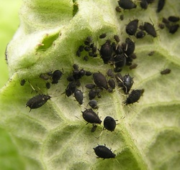
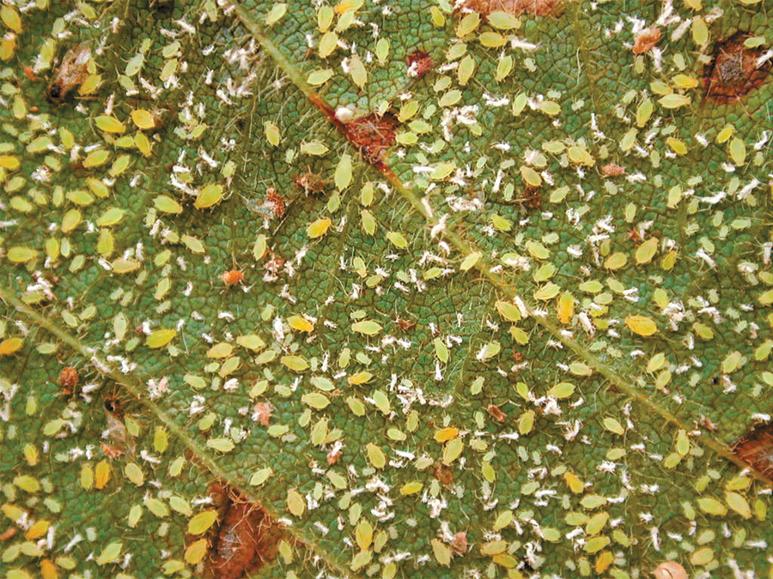
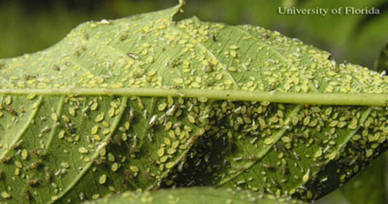
1
Notes:
Aphid

Slide 3
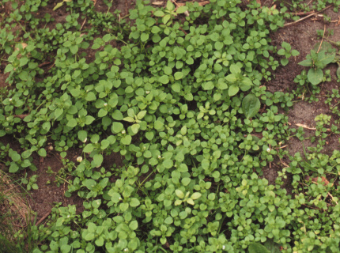
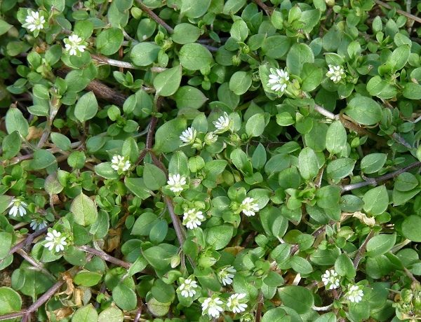
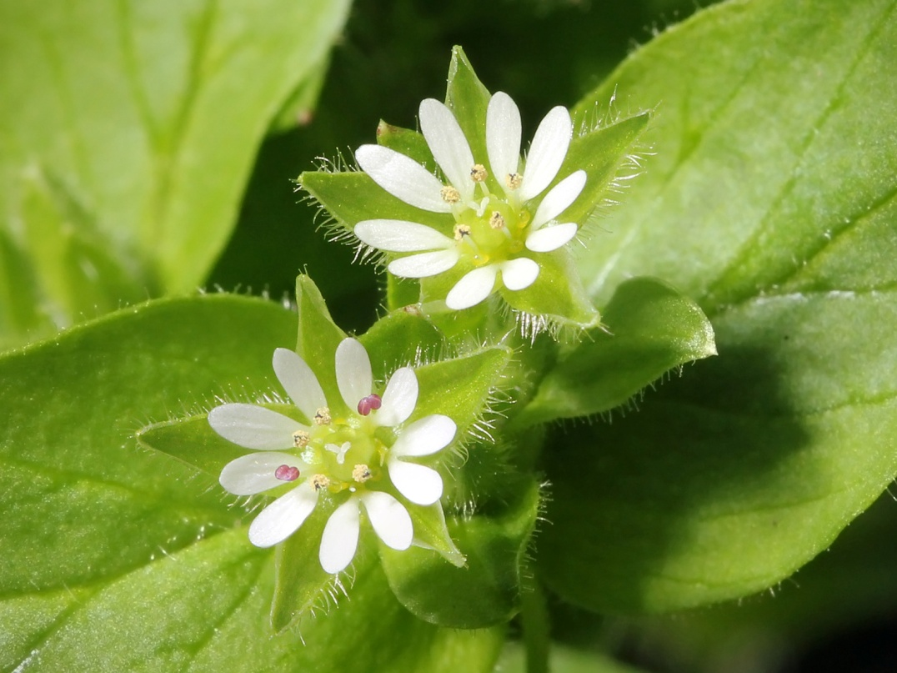
2
Notes:
chickweed

Slide 4
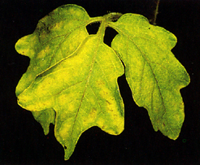
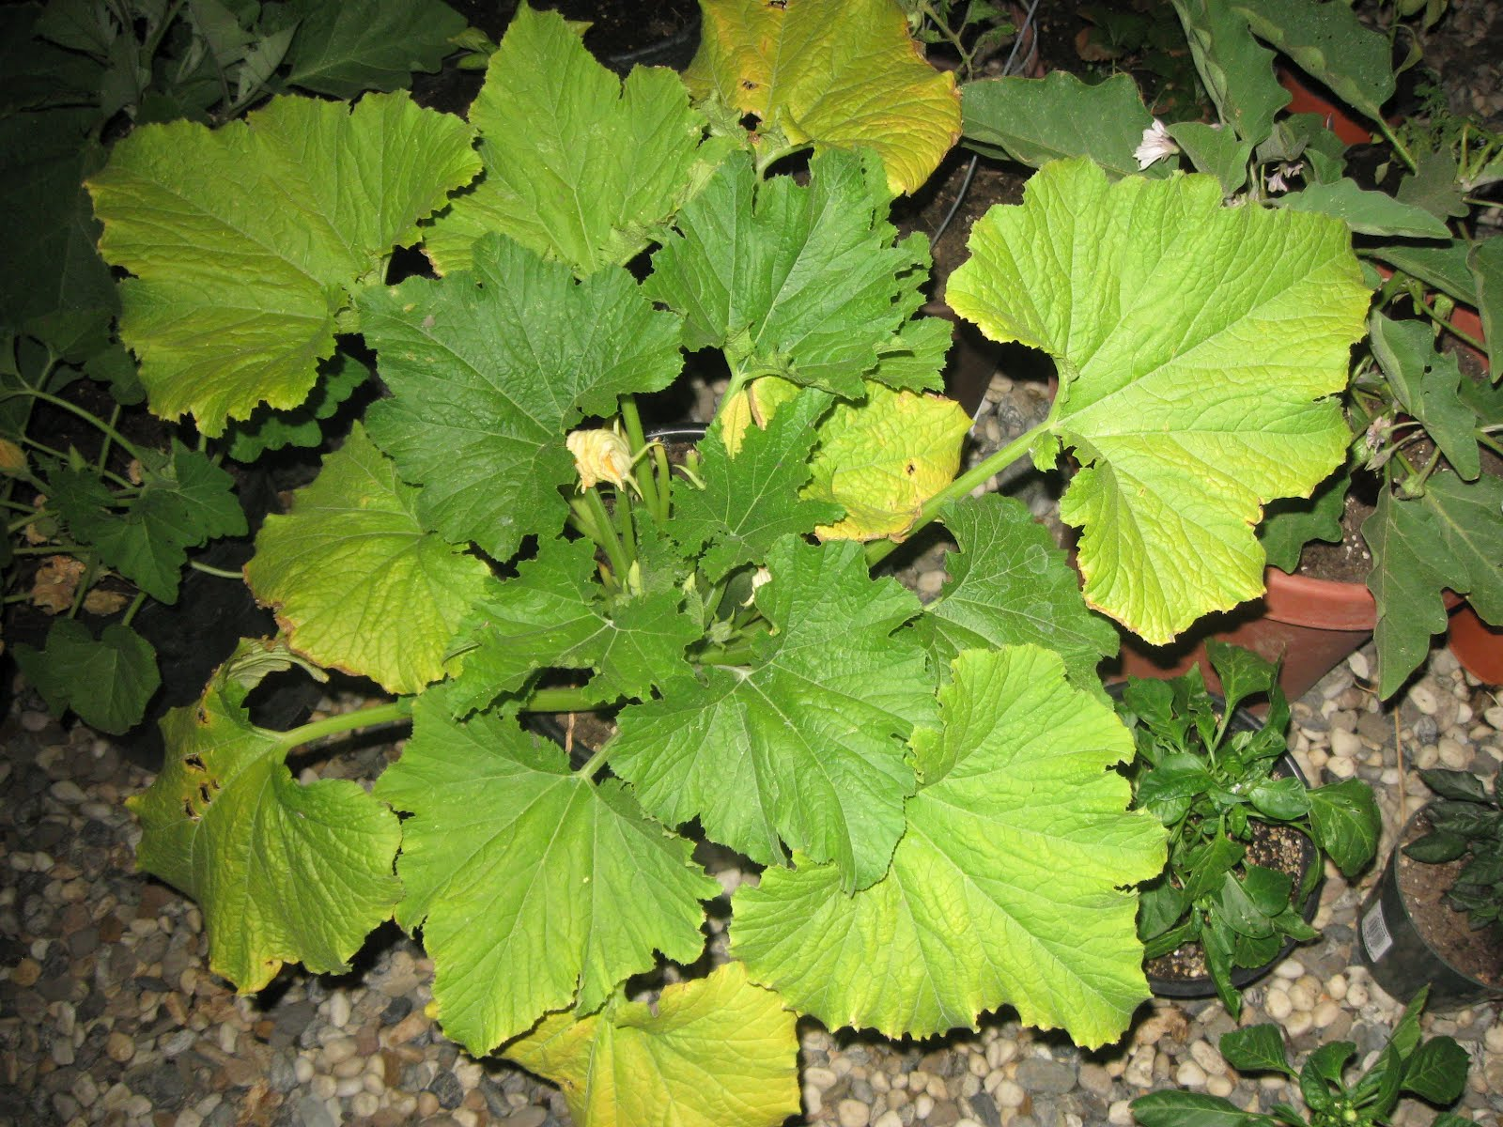
3
Notes:
N deficiency

Slide 5
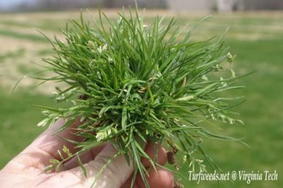
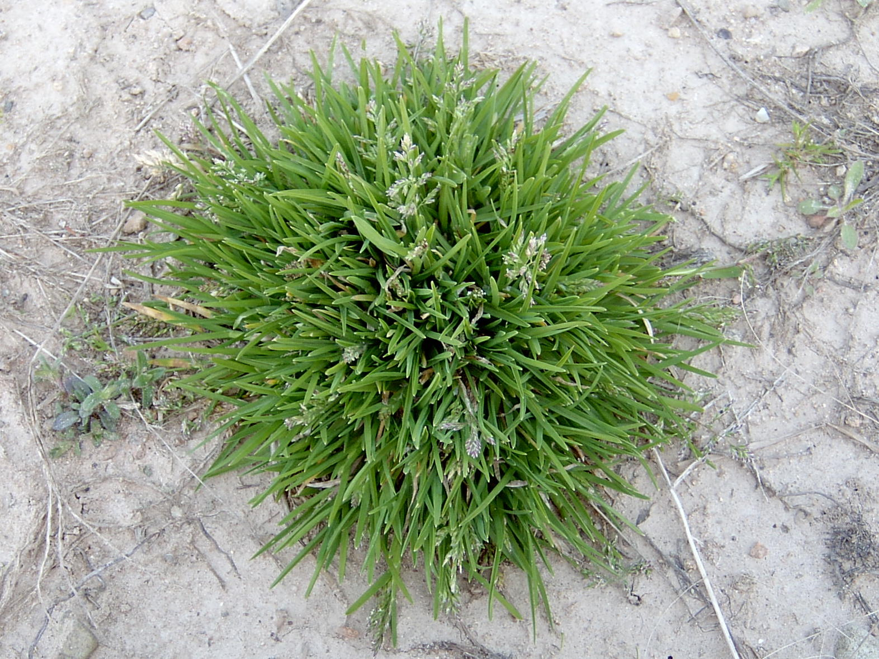
4
Notes:
Annual bluegrass

Slide 6
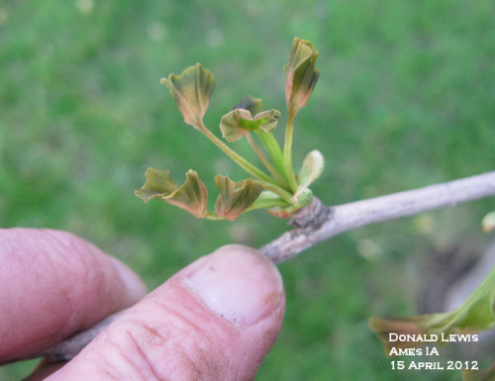
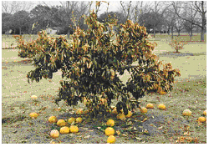
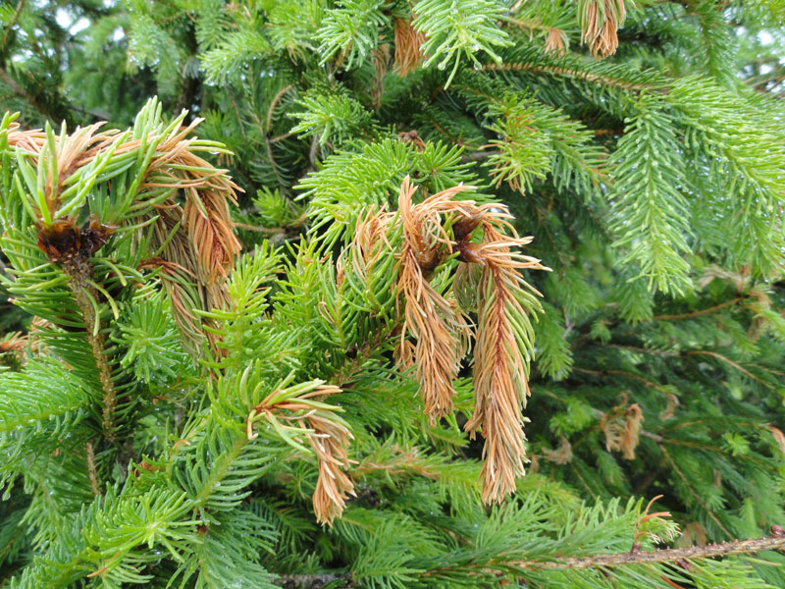
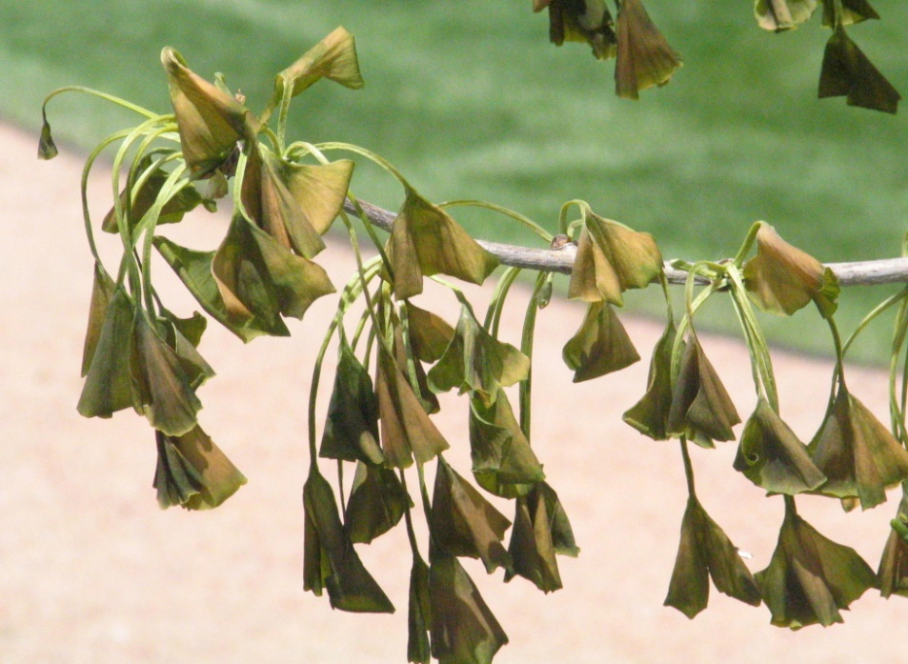
5
Notes:
Freeze damage

Slide 7
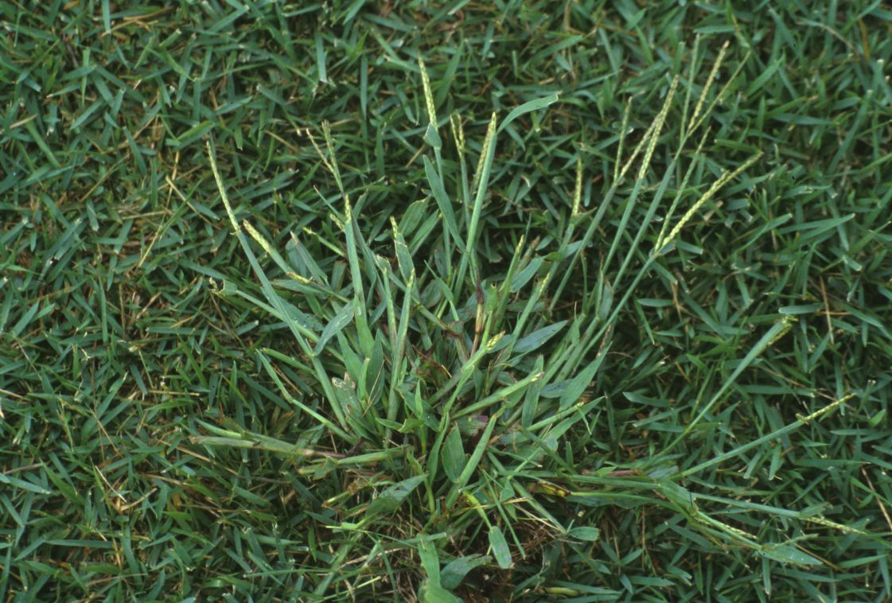
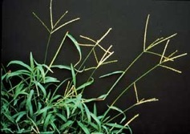
6
Notes:
Crab grass

Slide 8
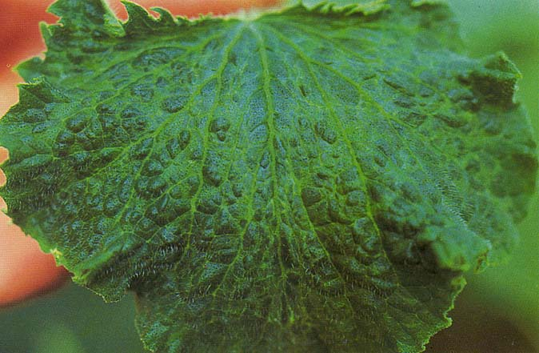
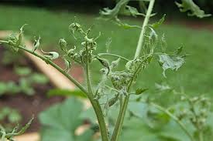
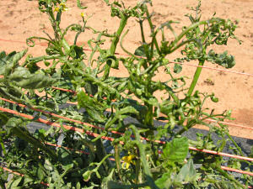
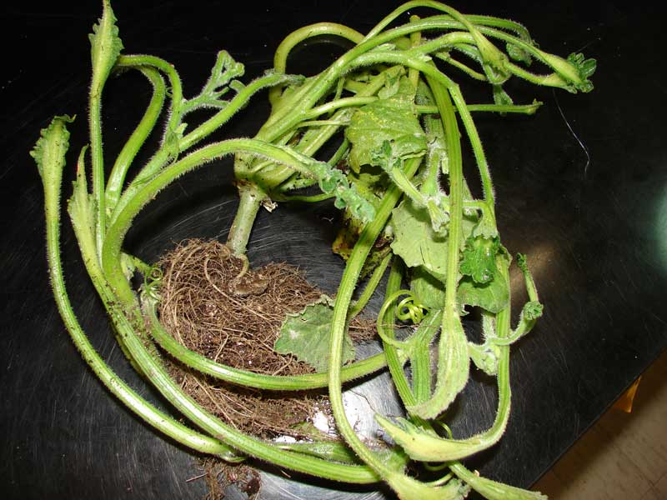
7
Notes:
2,4-D Injury

Slide 9
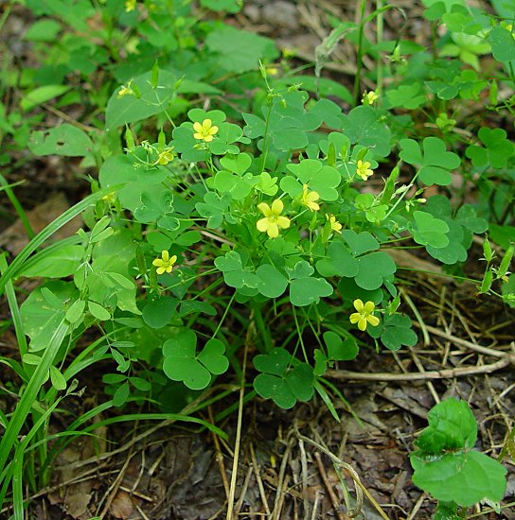
8
Notes:
Oxalis

Slide 10
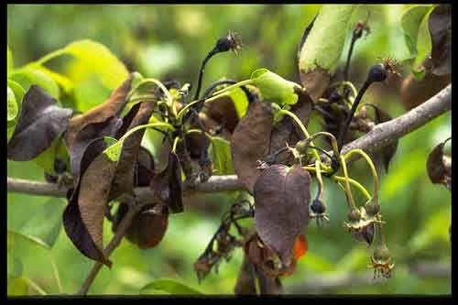
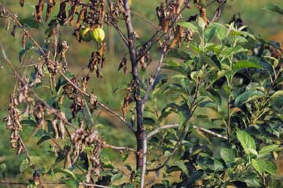
9
Notes:
Fire Blight

Slide 11
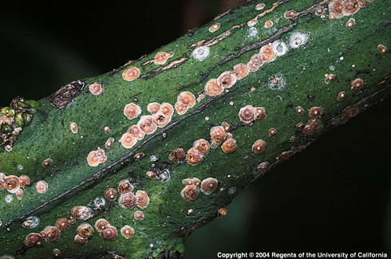
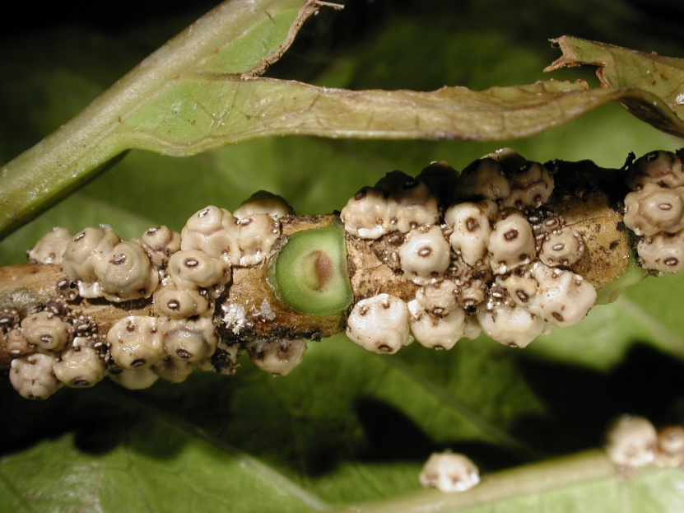
10
Notes:
Scale

Slide 12
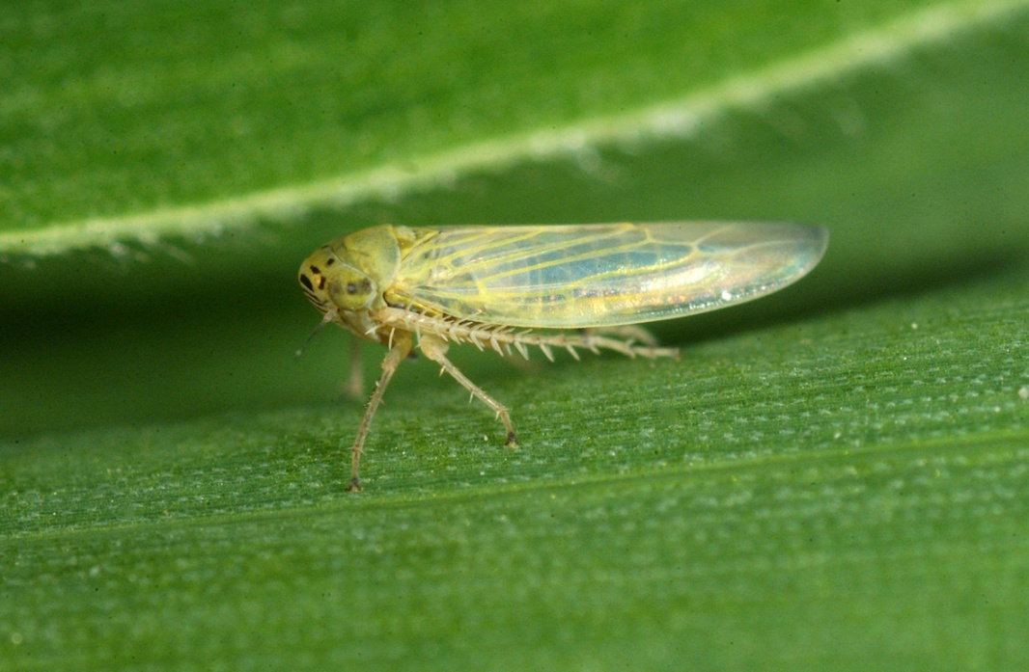
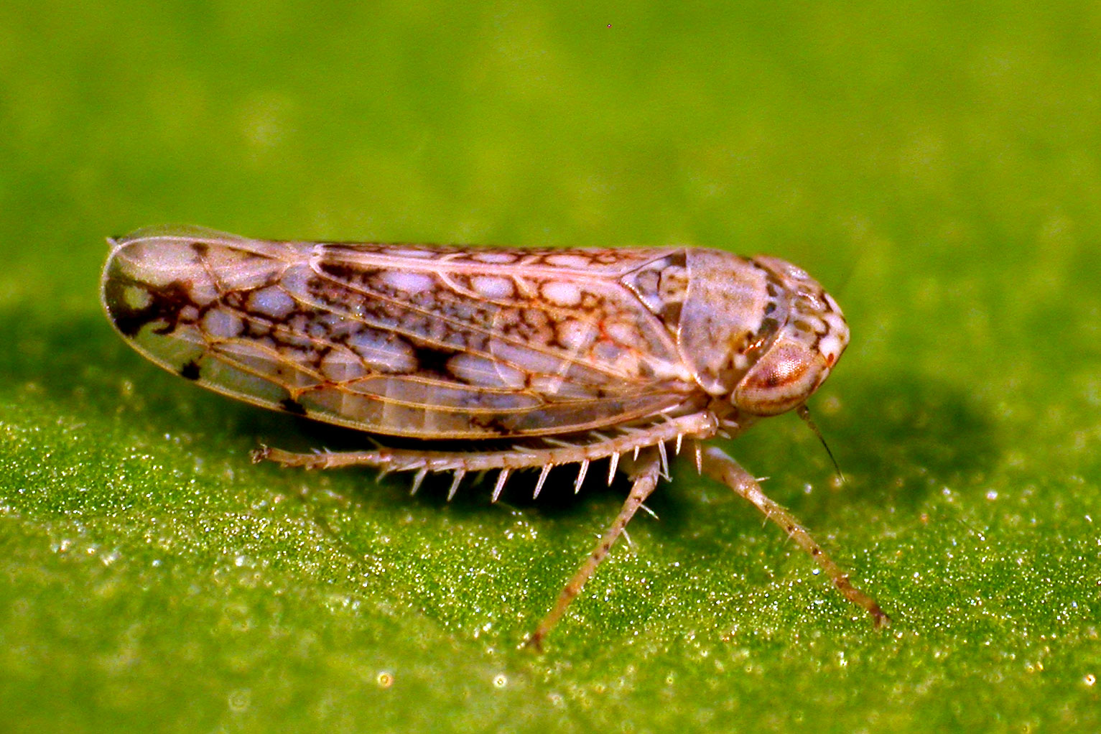
11
Notes:
Leafhopper

Slide 13
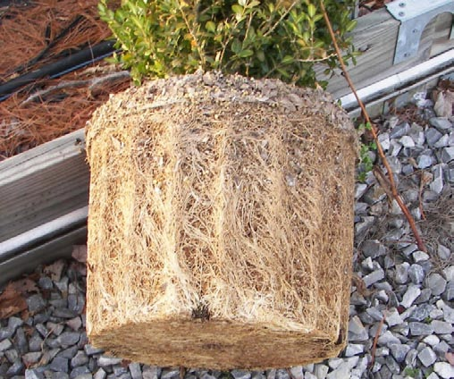
12
Notes:
Pot Bound

Slide 14
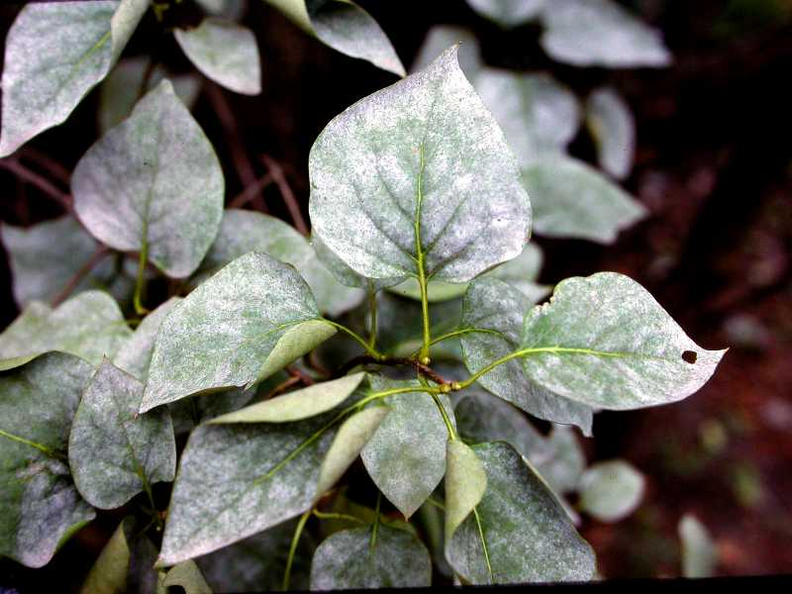
13
Notes:
Powdery Mildew

Slide 15
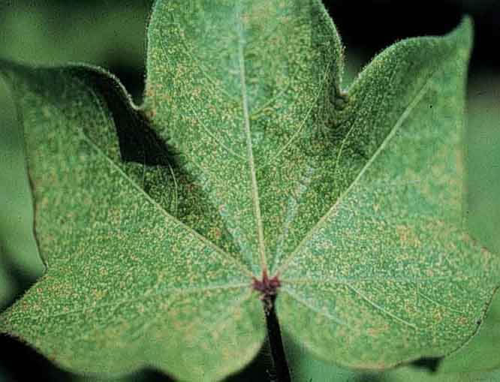
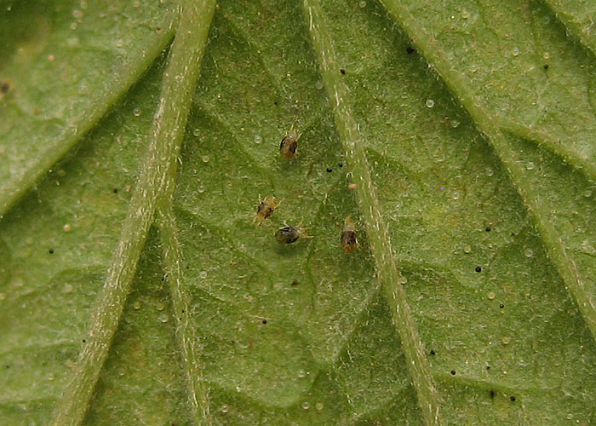
14
Notes:
Spider mites

Slide 16
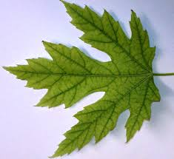
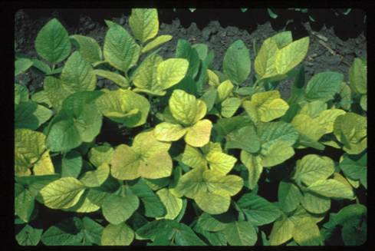
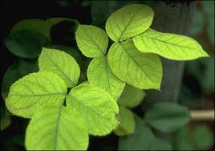
15
Notes:
Iron Chlorosis

Slide 17
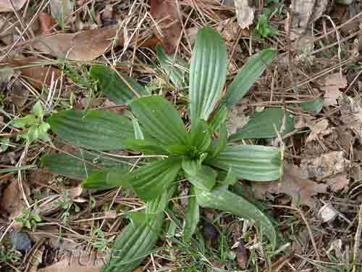
16
Notes:
Buckhorn Plantian

Slide 18
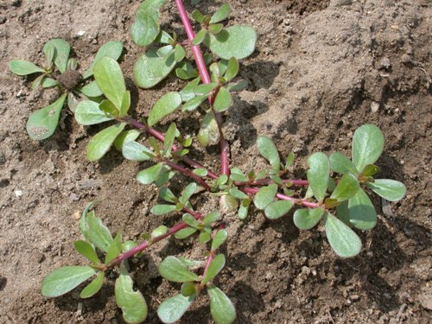
17
Notes:
Purslane

Slide 19
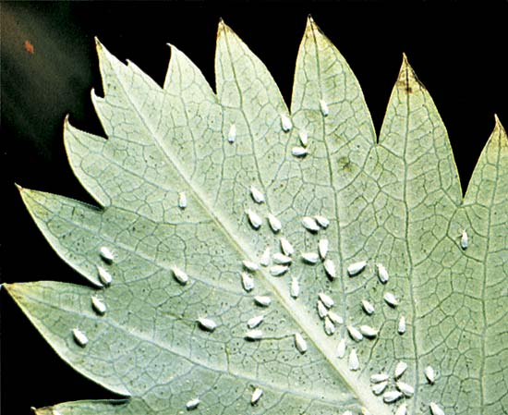
18
Notes:
Whiteflies

Slide 20
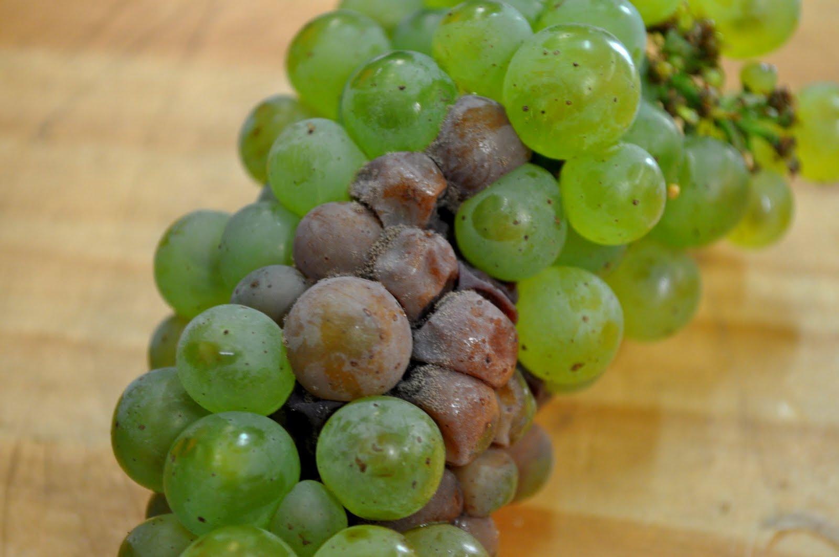
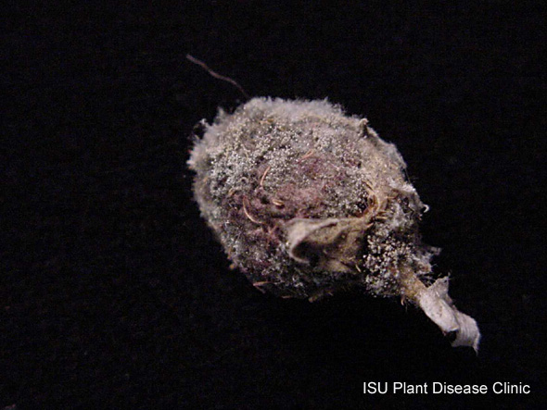
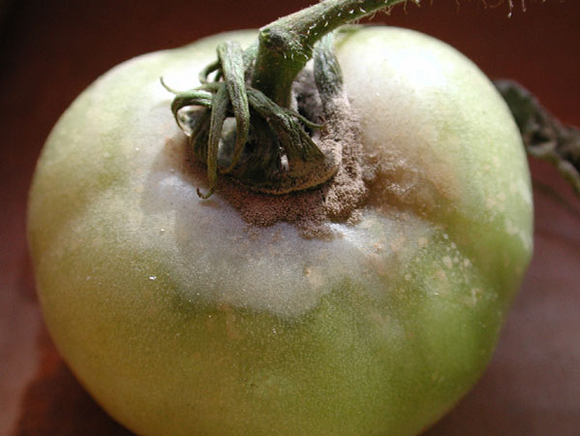
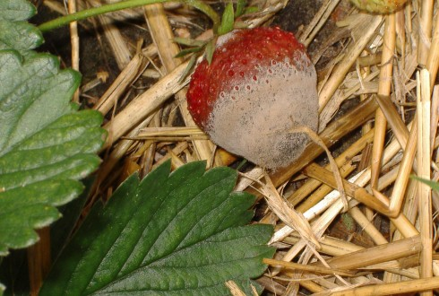
19
Notes:
Botrytis

Slide 21
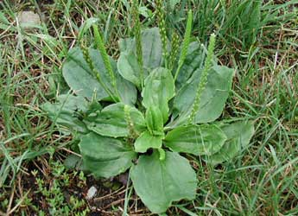
20
Notes:
Broadleaf plantain

Slide 22
Landscape Equipment

Slide 23
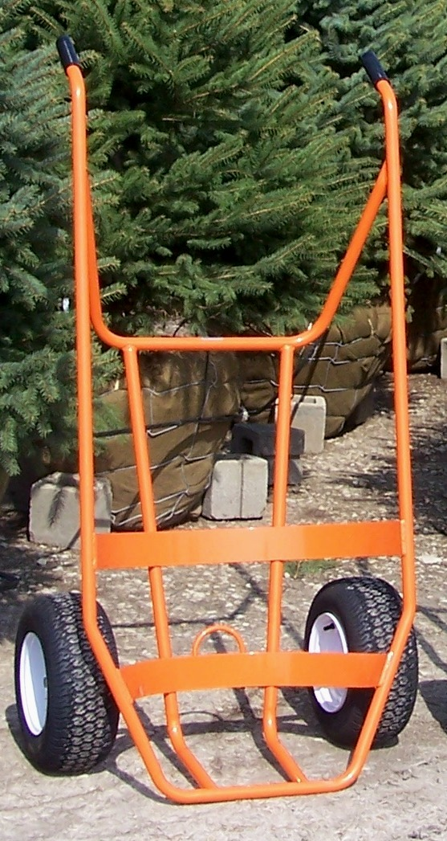
1
Notes:
B&B truck or cart

Slide 24
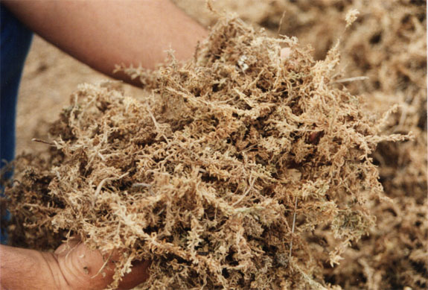
2
Notes:
Sphagnum Moss

Slide 25
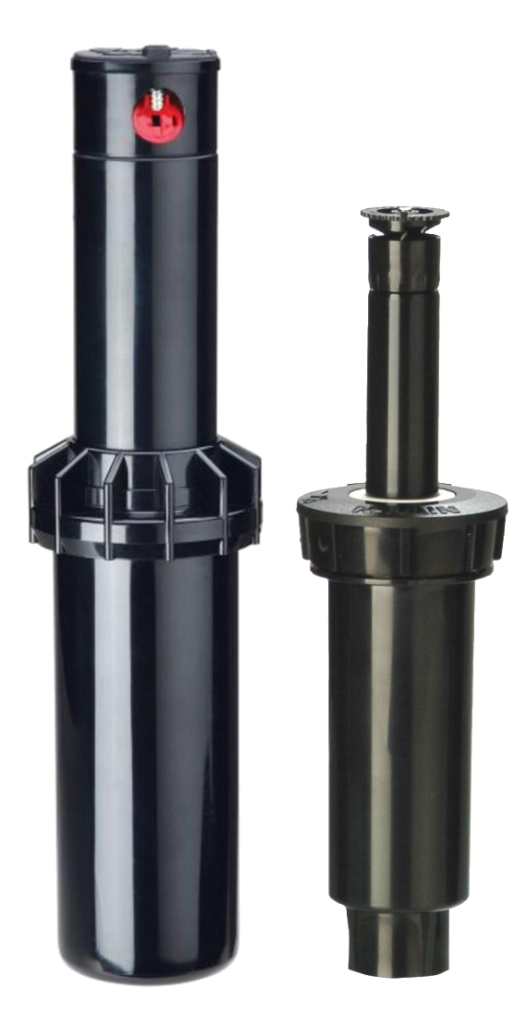
3
Notes:
Pop up sprinklers

Slide 26
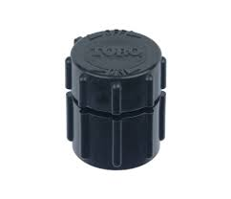
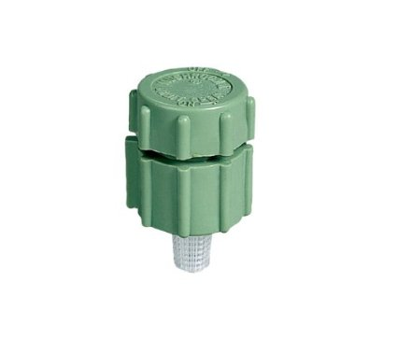
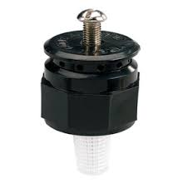
4
Notes:
Bubbler head

Slide 27
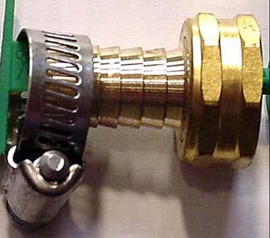
5
Notes:
Hose end repair

Slide 28
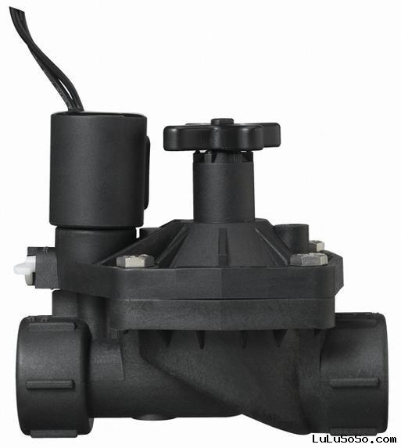
6
Notes:
Solenoid valve

Slide 29
7
Notes:
Reel mower

Slide 30
8
Notes:
Spark Plug gapper

Slide 31
9
Notes:
Drip emitter

Slide 32
10
Notes:
Lawn mower blade balancer

Slide 33
11
Notes:
Landscape bar`

Slide 34
12
Notes:
Mist nozzles

Slide 35
13
Notes:
Resign coated fertilizer

Slide 36
14
Notes:
Hose repair coupling

Slide 37
15
Notes:
Siphon propoprtioner

Slide 38
16
Notes:
Ploy pipe Polyethylene

Slide 39
17
Notes:
Chaps

Slide 40
18
Notes:
Bulb planter

Slide 41
19
Notes:
Shade fabric

Slide 42
20
Notes:
Pick ax

Slide 43
Plant Identification

Slide 44
1
Notes:
Boston Ivy

Slide 45
2

Slide 46
3

Slide 47
4

Slide 48
5
Notes:
English Ivy

Slide 49
6
Notes:
Sweet Alyssum

Slide 50
7

Slide 51
8

Slide 52
9

Slide 53
10
Notes:
Corn Plant

Slide 54
11

Slide 55
12
Notes:
Oregon Grape

Slide 56
13
Notes:
Spreading Cotoneaster

Slide 57
14
Notes:
Petunia

Slide 58
15
Notes:
Carpet bugle

Slide 59
16
Notes:
Schefflera

Slide 60
17
Notes:
Common Camellia

Slide 61
18
Notes:
Yew

Slide 62
19
Notes:
Zinnia

Slide 63
20
Notes:
Garden Verbena

Slide 64
21
Notes:
Little Leaf Box Wood

Slide 65
22
Notes:
Spotted Dumb Cane

Slide 66
23
Notes:
Bayberry

Slide 67
24
Notes:
Pothos

Slide 68
25
Notes:
Fescue

Slide 69
26
Notes:
Winter creeper

Slide 70
27
Notes:
Wax Begonia

Slide 71
28
Notes:
Plaintain Lily

Slide 72
29
Notes:
Bumalda Spirea

Slide 73
30
Notes:
Periwinkle

Slide 74
32
Notes:
Peony

Slide 75
31
Notes:
Shrubby Cinquefoil

Slide 76
32
Notes:
Sedum

Slide 77
33
Notes:
Meadow Sage

Slide 78
The End

Slide 79
29
Notes:
Oakleaf Hyrangea

Slide 80
1
Notes:
Leaf scorch

Slide 81
Notes:
Leaf miner

Slide 82
Notes:
Leaf Scortch

Slide 83
9
Notes:
N Deficiency

Slide 84
8
Notes:
Aphids

